Slide 1

RETAIL ANALYTICS
Analysis By -
Shreevidya Chandrasekar

Slide 2

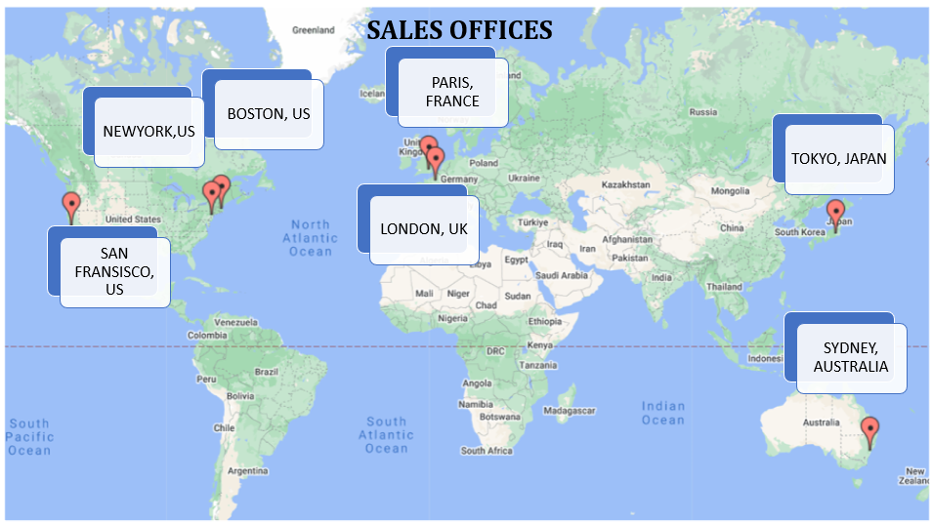
About the Company
Retail Company ‘ABC’ is the retail supplier of the toys to various region across country.
Goal
The goal is to empower retail stakeholders with actionable insights, enabling them to identify top-selling products, customer preferences, and target demographics and recommendations for targeted marketing, inventory optimization, and personalized customer experiences.

Slide 3


Slide 4
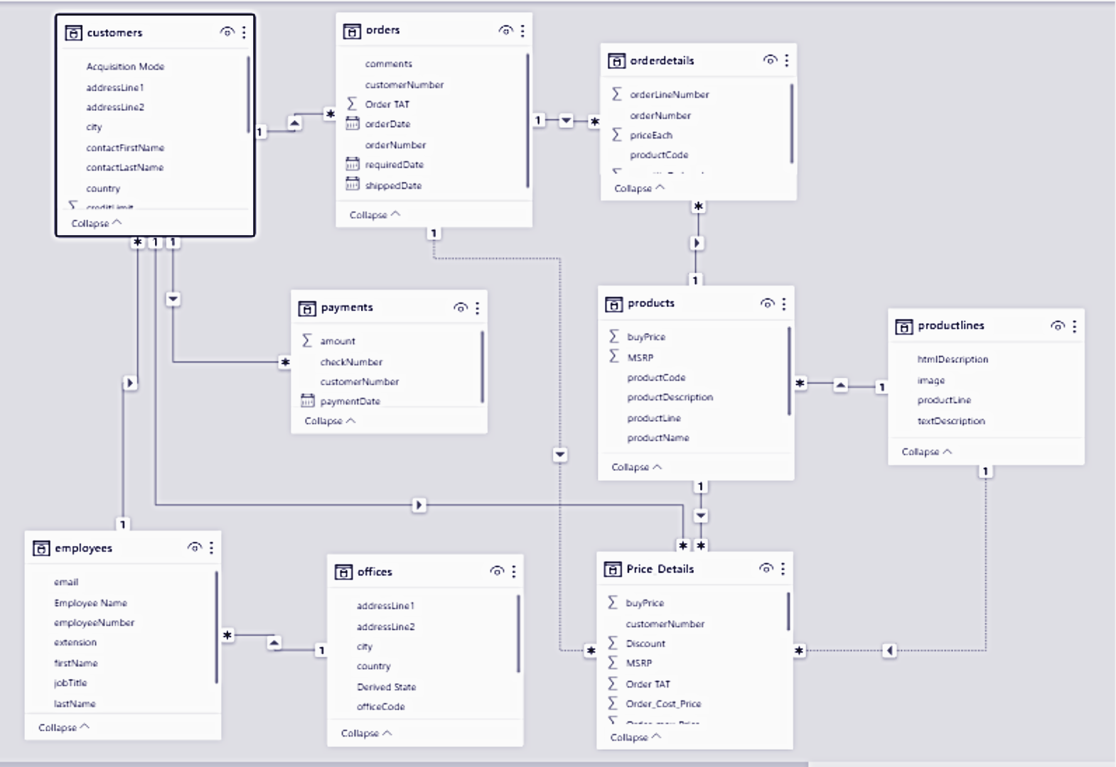
Entity Relationship Diagram

Slide 5
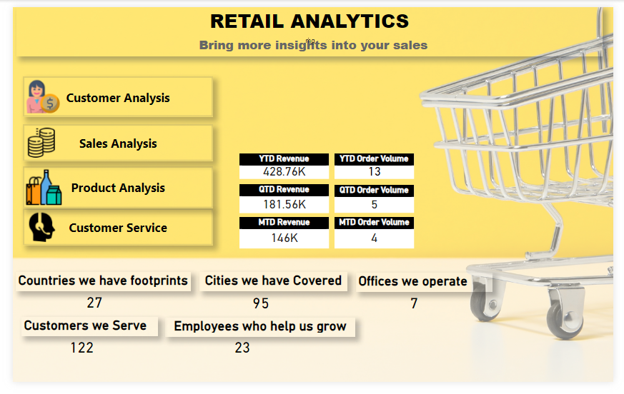

Slide 6
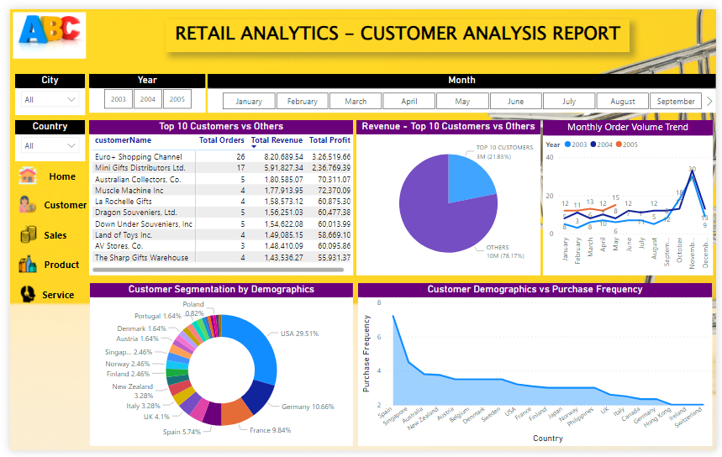

Slide 7
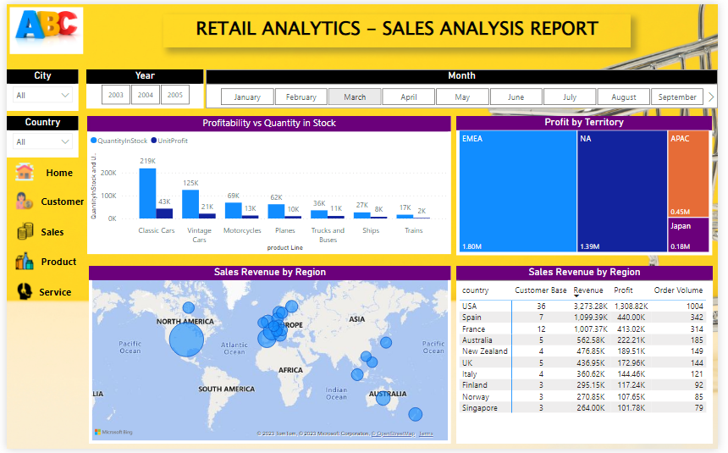

Slide 8
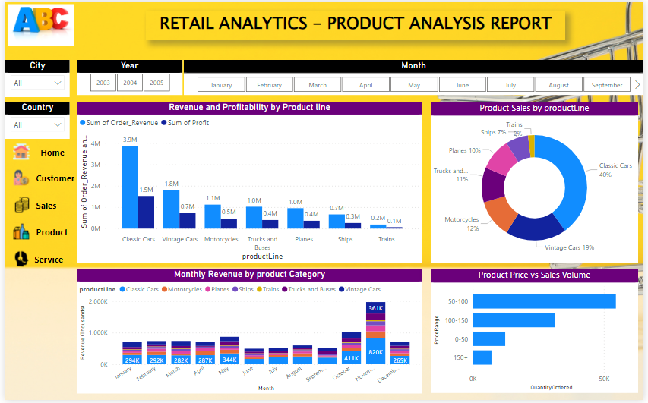

Slide 9
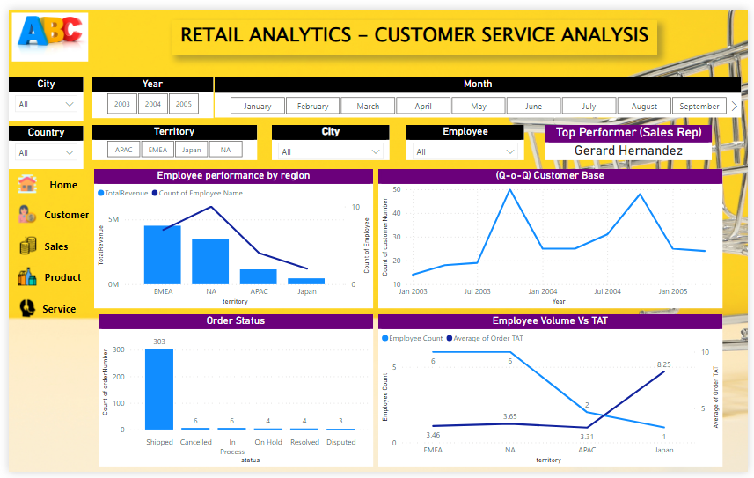

Slide 10

Insights (Sales Analysis)
Revenue for the Company has come predominantly from EMEA followed by North America (contributing to 83% of total sales)
APAC and Japan contributes to just 17% of total sales
Highest Sales in EMEA and NA is contributed by following factors
Customer Footprints
No of Orders by each customer
Average order value by each customer
No of Sales representative and no of Offices.

Slide 11
Insights (Sales Analysis)
October, November & December stands out to be the months of peak revenue due to the Holiday season owing to Christmas and New Year
ABC company is the seller of toys to the retailers, April and May has also seen to be a good season for sales due to summer Holidays.
Also, the sales figure doesn’t co-relate with the city of the customer and highest order value of the customer who belongs to Madrid serviced by the sales rep in Paris
APAC has highest Order per customer and Highest Revenue per customer which is operating with just 1 office and 2 employees

Slide 12
Insights (Product Analysis)
Revenue for the company has come mostly by selling the products under product line (Classic Cars and Vintage Cars), which contributes to 56%. Remaining revenue were contributed by 5 product lines.
Product Line ‘Trains’ followed by Ships contributed the least.
Product Scale of 1:18 followed by 1:24 were sold most.
Product '1985 Toyota Supra' is not being sold anywhere
Japan has been exposed to just 81 products for orders out of 109 product variance.
Product with price ranging 50 to 100 is yield high revenue followed by 100-150 which clearly states affordable pricing attracts customer the most.

Slide 13
Insights (Customer Service & Success Ratio)
Japan stands the top for excellent success ratio with all orders successfully shipped.

Slide 14
Recommendations
Following are the recommendation based on the data analyzed
Credit Limit of the customers should be increased over time, to increase the order volume and thus revenue.
Product Category Cars (Classic Cars and Vintage Cars) yield high revenue. Procurement of more of these product line and marketing will promote revenue.
Product Scale of 1:18 and 1:24 attracts most customers and hence should be targeted for bulk sales.
Company can off bundled sales by mixing Top selling Products & Least sold products for a discount.
To increase the Inventory of Product "1941 Chevrolet Special Deluxe Cabriolet" is sold more but the stock in hand is less when compared to other top selling products.
Product '1985 Toyota Supra' should be discontinued for further procurement. Existing stock of above products should be cross sold for discounted rate to the top customers.
Inventory check for in stock vs demand to be analyzed and corrected for peak seasons (Oct, Nov & Dec) and Grand sale to be offered.
‘Off seasons’ like Aug, Sep when the market is having less demand, More promotion and discounts should be concentrated to improve sales.
More offices can be operated in APAC region to increase customer base and revenue, since it has untapped potential.
Marketing strategies should be devised for Japan to expose all product variance.

Slide 15
Insights to dig
Following Insights can be brought up if we get following info
Data | Insights
Customer Age & Gender | Categorization of customers based on the Age as Young and Old and Gender, to promote marketing and products for target audience.
Relationship of Order and Payment | To establish the number of days between Order Date and Payment Date to identify the customers based on the delinquency of payment and credit limit utilization for loyalty-based promotions.
Customer Onboarding Date | To determine the lifetime of the customer and company relationship for loyalty-based promotions.

Slide 16


